Slide 2
FIRST CARDIAC CATHETERISATION
In 1929
Werner Forssmann
Rubber catheter
Through his own antecubital Vein
Upto the pulmonary artery
Diagnostic cardiac catheterization was introduced by André Cournand and Dickinson Richards in the early 1940s

Slide 3
FIRST SELECTIVE CORONARY ANGIOGRAM
Was an accident
Dr Mason Sones in 1958
After withdrawing a catheter after ventriculogram cannulated the RCA unknowingly
When contrast was injected for an aortogram selective opacification of RCA noted
Designed Sones catheter and popularized the technique
Several preformed catheters were later designed.

Slide 4
The goal is to examine the entire coronary tree (both native vessels and any surgically constructed bypass grafts) while recording details of the coronary anatomy, which include the following:
the pattern of arterial distribution (as small as 0.3 mm)
anatomic or functional pathology (atherosclerosis , thrombosis , congenital anomalies , or focal coronary spasm) , and
the presence of intercoronary and intracoronary collateral connections .

Slide 5
Coronary angiography - limited to examination of only the coronary lumen and not of the endothelial surface, plaque content, vessel wall, or ( except indirectly) coronary flow physiology. When features related to the above are in question , coronary angiography may be supplemented by intravascular ultrasound,optical computerized tomography, angioscopy, or intracoronary pressure and flow measurements.
Despite these limitations , selective coronary angiography still remains the clinical gold standard for evaluating coronary anatomy.

Slide 6
INDICATIONS

Slide 8
Contraindications
Unexplained Fever,
Untreated Infection
Severe Anemia(<8mg/Dl)
Severe Electrolyte Imbalance,
Severe Active Bleeding,
Uncontrolled Systemic Hypertension,
Digitalis Toxicity,
Previous Reaction To Contrast Material But No Pretreatment With Corticosteroids,
Ongoing Stroke

Slide 9
Acute Renal Failure
Decompensated Congestive Heart Failure,
Severe Intrinsic Or Iatrogenic Coagulopathy ([Inr] >2.0),
Active Endocarditis.

Slide 12
In the early years , coronary angiography used to be performed using the brachial artery cutdown approach.
The development of preshaped catheters and advancements in vascular access techniques have led to a progressive adoption of the percutaneous approach from the femoral, brachial, or radial artery.

Slide 13
Diagnostic catheter
Angiography
Pressure monitoring
Oxygen saturation monitoring

Slide 14
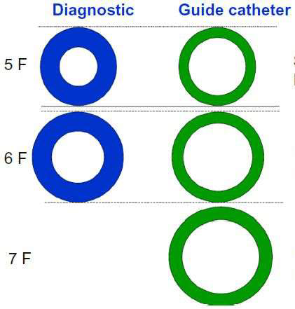
CORONARY CATHETERS
Diagnostic
GUIDE
Thicker shaft
Internal dm
Smaller
Tapering tip
Less Reinforced construction ( 2 layers)
Thinner shaft
Internal dm larger
Non tapering tip
More Reinforced construction ( 3 layers)

Slide 15
IDEAL CHARACTERISTICS OF A CATHETER
Better Torque Control
– Increase Outer diameter
– Reinforced construction
Pushability
– Increase Outer diameter
– Stiffer Material
– Decreasing overall part length
Flexibility
– Decrease Outer diameter
– Material with less modulus of elasticity
– Increasing overall part length
Trackability
Radio-opacity
Atraumatic Tip
Low Surface frictional resistance
Kink resistance

Slide 16
ANGIOGRAPHIC CATHETERS

Slide 17
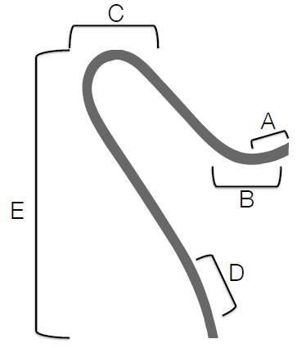
A) TIP LENGTH – Increased length offers more
stability in target vessel at the cost of
maneuverability in the parent vessel.
B) PRIMARY CURVE – angle of the target vessel
from its parent artery.
C) SECONDARY CURVE -- width of the parent
vessel.
D) TERTIARY CURVE –normal curvature of the
parent vessel.
E) CATHETER LENGTH – Usually 100 or 110 cm

Slide 19
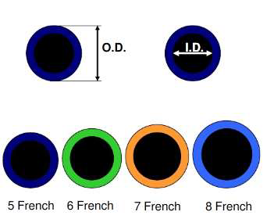
FRENCH CATHETER SCALE:
The French catheter scale is commonly used to measure the outer diameter of cylindrical medical instruments.
D(mm) = Fr/3
Most commonly in adults -- Diagnostic Catheters of 5 – 7 Fr size.

Slide 20
POLYURETHANE | POLYETHYLENE | POLYVINYL CHLORIDE | TEFLON
Excellent tensile strength |  | Very poor tensile strength
Softer than polyethylene or Teflon – Less vascular trauma | Stiffness inbetween Polyurethane & Teflon. | Softest & flexible among all | Stiffest – no suitable for selective catheters
Increased thrombogenicity | More Thrombogenic than PVC, polyurethane | Increased thrombogenicity
pigtail angiographic (cordis) catheters & original judkins catheters. | Eg – pigtail angiographic catheters, judkins catheters | Eg- Balloon-tip flow directed catheters. | Eg – Brockenbrough catheters, transducer-tip catheters & introducer sheaths.

Slide 21
SIDE HOLES
Advantages
Prevent catheter damping (occlusion of the coronary ostium)
Allow additional blood flow out of tip, to perfuse the artery.
Avoid catastrophic dissections in the ostium of the artery
Avoids Disengagement during Injections
Disadvantages
False sense of security because now, aortic pressure,and not the coronary pressure is being monitored.
Suboptimal opacification
Makes catheter tip weak - kinking at side holes

Slide 22
Catheter Choices

Slide 23
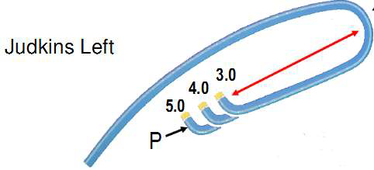
Catheters used for native coronary
Curve length = distance between P
(primary curve) & S (secondary curve)
Notes:
Tapered tip with end hole
Designed for femoral route

Slide 24
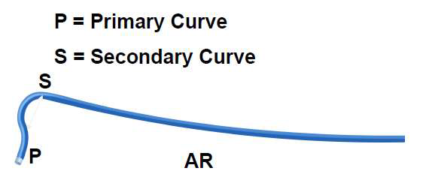
Notes:
Coronory ostia out of conventional judkins Like high and posterior origin..
It can selectively canulate LAD or LCX if short left main stem.
Separate origins of left anterior descending and left circumflex coronary arteries.
High anterior right coronary arteries (RCAs) or Shepherd’s Crook RCA.

Slide 25
MULTIPURPOSE CATHETER
Polyurethane catheter
Single curve with straight tip an end hole and two side holes.
Use: CAG – Both native vessel and graft ,Ventriculography , Right heart catheterization.
MP A-1 : 1 end hole only
MP A-2 : 2side holes ,1end hole
MP B-1 : 1 end hole only
MP B-2: 2 sideholes and an end hole

Slide 27
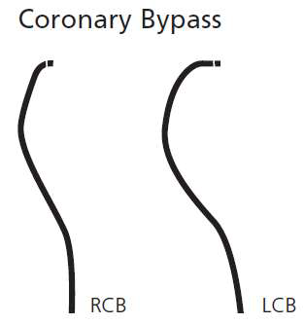
BYPASS CATHETERS
■ RCB
– Resembles JR4 with a tip curved >90
degree
■ LCB
– Primary curve similar to JR4 ( 90 degree )
but secondary curve more acute ( 70
degree)

Slide 28
Internal mammary catheter
Resembles Judkins right except for
tighter primary curve (80degree) and
longer tip

Slide 29
others

Slide 30
Vascular access

Slide 31
Femoral – modified seldinger techniqe

Slide 32
Mosqito catheter

Slide 33
Intravascular ultrasound guidence
The femoral artery appears as a
pulsatile circle, usually with thicker and brighter delineation
of the walls and on occasion with atherosclerotic and calcific
plaques.
Upon gentle pressure with the vascular probe, the artery is not compressible and the pulsations become more evident.
The arterial bifurcation is identified by scanning north to
south, in order to prevent puncture at this level

Slide 34
When the femoral pulse is difficult to palpate or numerous needle insertions have been fruitless ,
it may be easiest to use the 18-gauge SmartNeedle .
The obturator of this device contains a Doppler crystal that picks up pulsatile arterial or more continuous venous flow,and thereby helps aim the needle tip toward the center of the desired vascular lumen.

Slide 35
A high puncture above the inguinal ligament - catheter advancement difficult and predisposes to inadequate compression, hematoma formation, and/or retroperitoneal bleeding following catheter removal.
A low puncture of the artery (at or below the femoral bifurcation or >3 em below the inguinal ligament) – high chance of puncture will be at the bifurcation of femoral branches and will fail to enter the arterial lumen.
Puncture of either one of the branches increases the risk of false aneurysm formation or thrombotic occlusion owing to smaller vessel caliber.
Because the superficial femoral artery frequently overlies the femoral vein, low venous punctures may pass inadvertently through the superficial femoral artery, leading to excessive bleeding and possible arteriovenous(A-V) fistula formation.

Slide 36
RIDING THE GUIDEWIRE
Difficulties occurs at various level
At or just beyond the tip of the needle and is not corrected by slight depression or slight withdrawal of the needle.
Initially free, but resistance is encountered after several centimeters(esp with pain) - Extensive iliac disease or subintimal wire position.
Advancing the wire above the aortic bifurcation(AAA) - overcome b y use of a floppy steerable or hydrophilic (Glidewire , Terumo) guidewire, carefully reintroduced with extreme care to avoid perforation,dissection , or dislodgment of atherothrombotic debris.

Slide 37
Insertion and Flushing of the Coronary Catheter
The Catheter with guidewire to arch and into the ascending aorta – double flushed – attach to manifold – record baseline tip pressure – contrast & look for alteration in tip pressure – proceed to selective engagement of coronary,

Slide 38
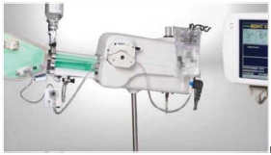
Four port cronary manifold & Bracco Acisst device

Slide 39
Damping and Ventricularization of the Pressure Waveform
A fall in overall catheter tip pressure (damping) or a fall in diastolic pressure only (ventricularization)
Indicates obstruction of the catheter tip or interference with coronary inflow.
The catheter tip may have been inserted across a proximal coronary stenosis or may have an adverse catheter lie that places it against the coronary wall – Withdraw the tip & reengage cautionaly.
Vigorous injection despite a damped or ventricularized pressure waveform should be avoided, however, since it predisposes to ventricular fibrillation or dissection of the proximal coronary artery with maj or ischemic sequelae.

Slide 40
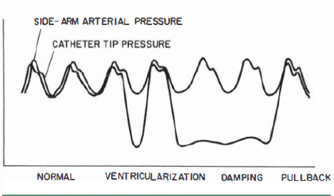
The Generally Smaller Caliber Of The Vessel (Particularly In Nondominant Vessels
Ostial Spasm Around The Catheter Tip
Selective Engagement Of The Conus Branch
True Ostial Stenosis .

Slide 41
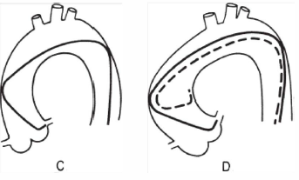
Cannulation of the Left Coronary Ostium

Slide 42
Left coronary ostium - (typically high and posterior)as seen in RAO - limited counterclockwise rotation of the left Judkins catheter facilitate engagement OR left Amplatz catheters is used.

Slide 44
Cannulation of the Right Coronary Ostium

Slide 45
Catheters with smaller ( 3 . 5 em) or larger ( 5 or 6 em) Judkins curves or right Amplatz catheters(AR 1 or AR2) may be used if engagement difficult.
Sometimes , the right coronary ostium lies high and anterior above the commissure of the left and right aortic valve leaflets rather than in the middle of the right sinus . If not been possible to engage ,a nonselective injection should be performed into the right sinus of Valsalva . This will show the high-anterior origin and trigger a change to a left Amplatz ( either AL0 . 7 5 or AL l ).

Slide 46
Cannulation of Saphenous Vein and Arterial Grafts
Right Grafts
– Primary choice - MP
– Alternative – JR , RCB , AL
Left Grafts :
– Primary Choice – JR4 , AL1
– Upward trajectory may require - LCB , IM , HS
– More anterior origin – AL , HS > JR , LCB , MP

Slide 47
Left Coronary Artery Graft
Preferred view for engagement - RAO with the tip of the catheter pointing anteriorly (to the right of the angiographic view).
generally use a JR4 or an AL l catheter to engage anterior(i. e . , left) coronary grafts .
Special left coronary bypass,internal mammary, or hockey stick catheters may be required for left grafts that originate with an upward trajectory

Slide 48
right coronary grafts
Preferred view for engagement – LAO with the tip of the catheter pointing downward and toward the right of the aortic wall (left in the angiographic view)
For downward-pointing right coronary grafts - we prefer a soft catheter with no primary curve (a multipurpose,Wexler, or JR3 . 5 short-tip catheter)

Slide 50
Internal Mammary Artery Cannulation
Femoral approach using a soft-tip preformed internal mammary catheter, which resembles a right Judkins catheter except for a tighter primary curve.
Notes:
common anatomic variants in the internal mammary artery - more proximal origin in the vertical portion of the subclavian or origin as a common vessel with the thyrocervical
trunk.

Slide 51
In the LAO proj ection, cannulation of the left internal mammary artery begins by advancement of this catheter into the aortic arch until it lies j u s t inside the left edge of the wedgelike density formed by the shadow of the upper mediastinum against the lung fields .
With l to 2 cm of J guidewire protruding from its tip , the mammary catheter is rotated counterclockwise and slowly pulled back until it falls into the subclavian artery origin.
From there , the wire can be advanced well out into the axillary artery. The mammary catheter is then advanced over the wire , into the midsubclavian, where the guidewire is then removed and the catheter is flushed and filled with contrast.
Switching to the straight AP projection, the catheter is rotated counterclockwise slightly (to make the tip point slightly anteriorly) as it is withdrawn slowly until the internal mammary is engaged.
Rt mammary artery -
Notes:
A low-osmolar contrast agent should be used to avoid causing CNS toxicity by reflux of hyperosmolar ionic contrast up the vertebral arteries.

Slide 52
When selective cannulation difficult
Nonselective injections into the subclavian (but generally not to provide detailed information about the distal native vessel.)
Inflation of a blood pressure cuff on the ipsilateral arm may help reducerunoff through the axillary artery and improve opacification.
Y connector can be attached to the hub of the diagnos catheter and a 0.014-inch soft-tipped coronary angioplasty guidewire can be advanced into IMA.

Slide 53
Within the first 6 months after surgery,most commonly the lesion is located at the distal mammary coronary anastomosis . It occurs usually owing to local intimal hyperplasia rather than atherosclerosis and responds well to balloon angioplasty.
It is also important to look
1)large nonligated side branches that may divert flow from the coronary circulation and occlusion of which may be required for angina relief.
2)stenosis in the subclavian artery
Notes:
Years later significant lesions may develop in the native coronary artery.

Slide 54
Gastroepiploic Graft Cannulation
Standard Visceral Angiographic
Catheters (E.G. , Cobra) Designed To Enter Visceral Arteries Such
As The Celiac Axis Till GDA
A 0 . 0 2 5 -Inch Glidewire (Terumo) Can Then Be Used To Cannulate The Right Gastroepiploic

Slide 55
RADIAL APPROCH
With an average diameter of 2 . 8 mm in females
and 3 . 1 mm in males , the radial artery is compatible with 6F
sheaths.

Slide 56
ADVANTAGE
The flat, bony prominence - ease of compression and hemostasis after sheath removal.
Vast collateralization of the radial artery through the palmar arch prevents ischemia of the hand.
Because the puncture site is not overlying a joint, motion of the hand or the wrist does not increase the risk of bleeding
Because of the absence of major adjacent nerve structures, there is no risk of neurologic sequelae.

Slide 57
Uncommon anatomic anomalies
Tortuous radial configurations.
Stenoses , hypoplasia , radioulnar loops.
Aberrant right subclavian artery (arteria lusoria) , and subclavian tortuousity.
Abnormal origin of the radial artery(esp high radial artery origin)
Notes:
Most are unilateral, so take left arm.

Slide 58
Preprocedure Assessment
Avoid I V lines in wrist.
Sedation is strongly recommended to decrease catecholamine release that can potentially contribute to radial spasm.
Allen's test - subjective and 30% of falsely abnormal results
THE BARBEAUGRADING SYSTEM

Slide 60
Patient Positioning- Right versus Left Radial Access
Notes:
1)left TRA should be strongly considered in patients who have undergone ( CABG ) , because it provides direct access to the (LIMA.
2)prevalence of subclavia tortuosity and radial loops is three times higher in the right upper extremity.With right TRA the catheter has to pass through the right subclavian artery and the brachiocephalic trunk before reaching the aortic root . These two areas of bifurcation can increase technical difficulty esp when these vessels are atherosclerotic, tortuous, and calcified).

Slide 62
Radial Puncture
TRA kits - micropuncture needle, a short 0.018 to 0.021 inch wire, arterial sheath with or without hydrophilic coating of shorter ( 1 0 to 13 cm) or longer (23 cm)length.
Front wall technique.
Back-wall technique - Simpler, more reproducible,easier to teach, allows easier advancement of the wire,arterial pulsatile blood return is easier to recognize.
Notes:
1) hydrophilic coating allows easier sheath removal and is clearly associated with less spasm and patient discomfort

Slide 63
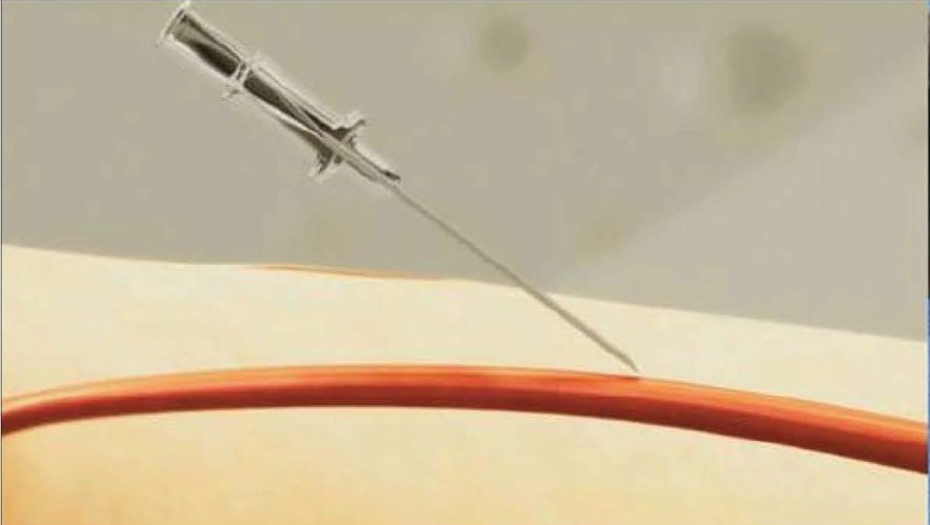
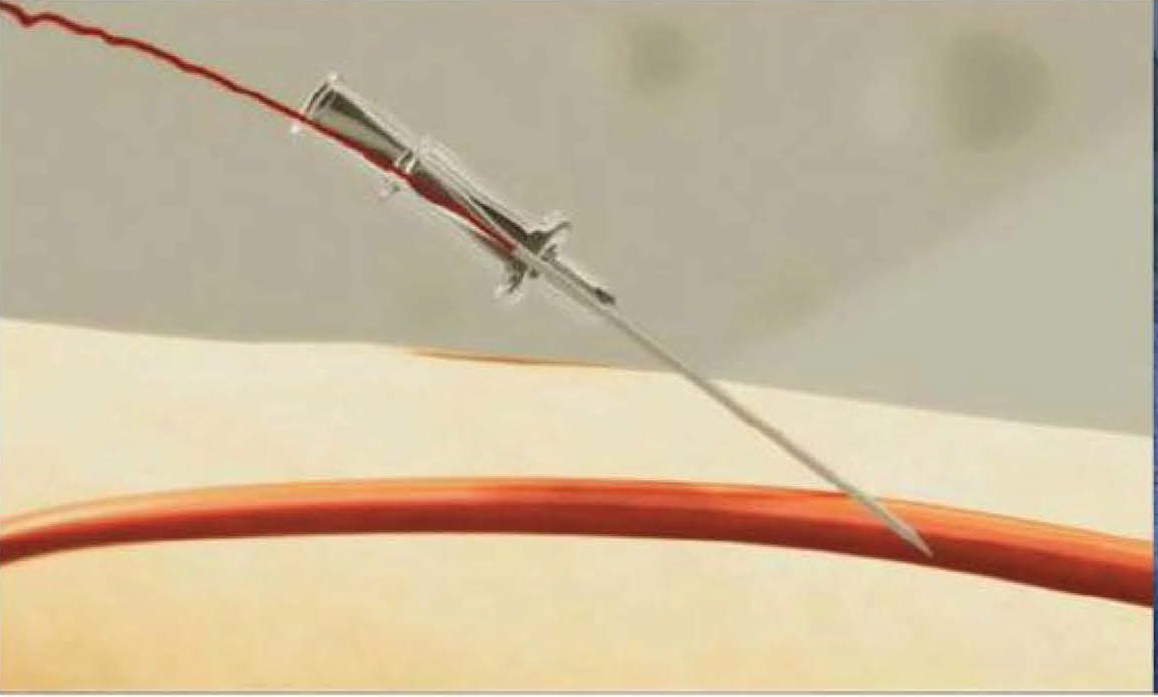
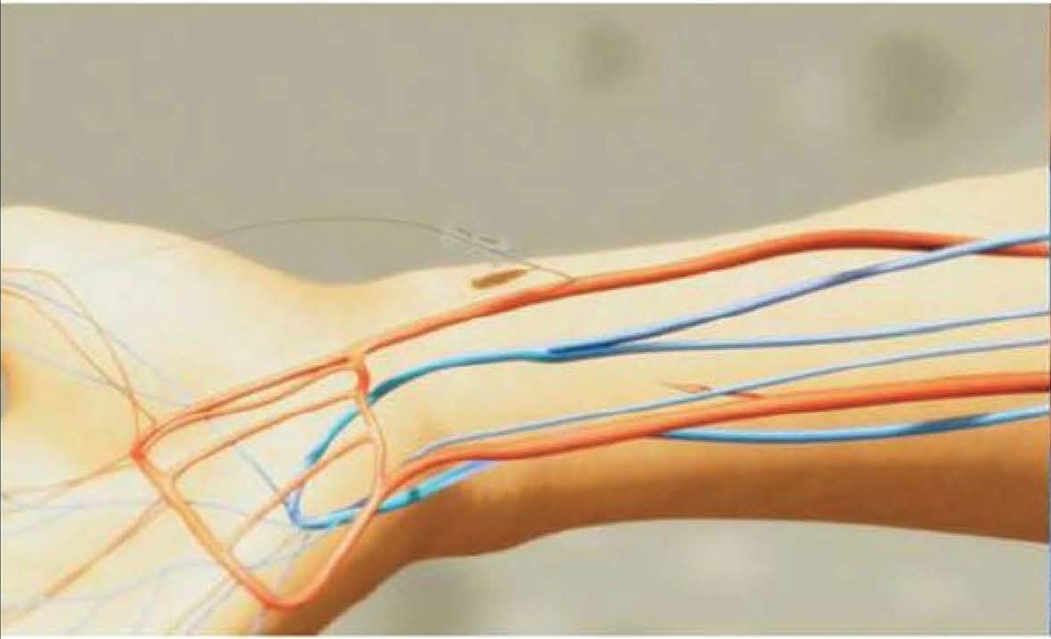

Slide 64
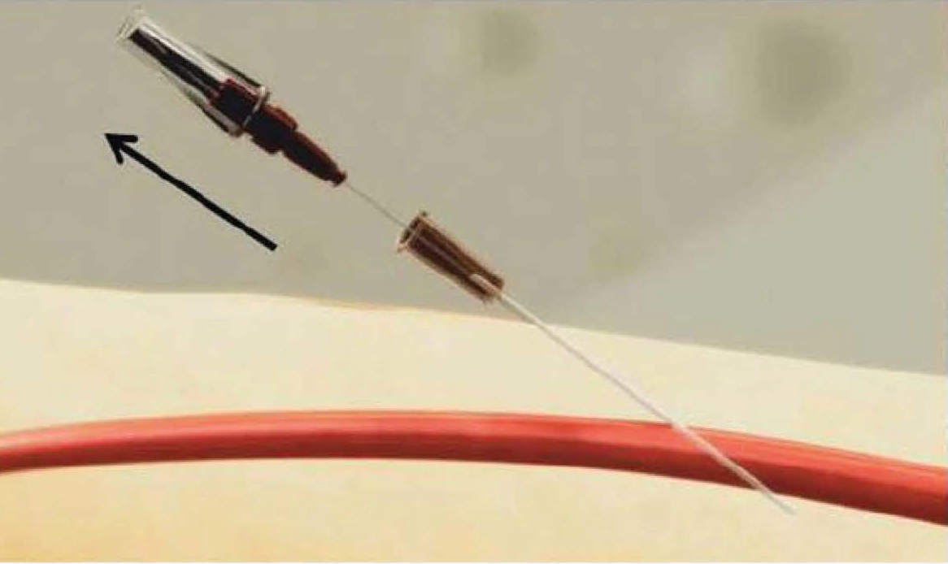
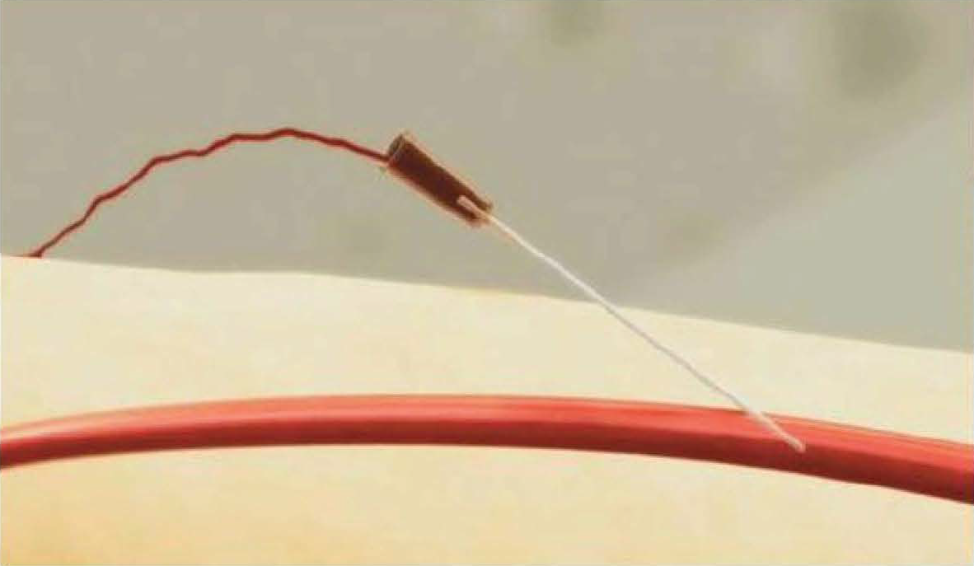
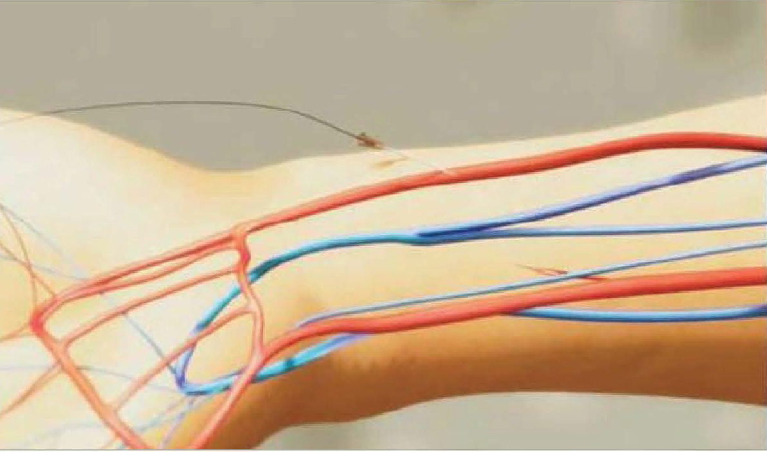

Slide 65
Prevention of Radial Artery Spasm
The radial artery spasm more common due to its smaller caliber, large muscular media, and higher receptor-mediated vasomotion.
Independent predictors - presence of radial artery anomalies, multiple catheter exchanges , pain during radial cannulation, larger catheter diameter, and small radial artery caliber.
injection of vasodilator through the sidearm of the sheath immediately after obtaining access
In case of catheter or sheath entrapment due to spasm – warm wet compresses can be applied over the skin of the upper extremity and the sheath or catheter slowly removed or in extremely severe cases , regional nerve block may be required.

Slide 66
Forearm bleeding and hematoma
Circumferential compression to the forearm should be applied as soon as the diagnosis is suspected by wrapping the forearm with an elastic bandage or a blood pressure cuff inflated up to 15 mmHg below the systolic blood pressure ,until the coagulation parameters return to normal values

Slide 67
GUIDEWIRE
0.035 inch guidewire and a catheter of choice are advanced.
J tip wires - may cause vasospasm.
Angled-tip hydrophilic guidewires – risk of side branches entry
Radioulnar loops and tortuosity in the radial or brachial arteries can be identified and negotiated with the 0 . 0 1 4 inch coronary wire of choice with the support of a 4F hydrophilic coated Cobra or angled catheter compatible with a 0.035inch guidewire .
Significant subclavian tortuosity can be negotiated by use of a stiff shaft hydrophilic-coated guidewire . Having the patient take a deep breath can also straighten the vessel.

Slide 68
CATHETER SELECTION
Judkins catheters - it is recommended to downsize the curve of the JL catheter from 4.0 to 3.5 and for the right coronary to use either a jR4 or JR5 .
Shapes for single-catheter approach include the multipurpose, Kimney, MAC , Tiger, Sarah , and jacky catheters.
For CABG pt, the left radial approach is preferred as it allows easy cannulation of the LIMA,usually with an IMA or a VB- 1 catheter & SVG using MP or JR4 for right sided graft , Amplatz left catheters for grafts arising from the anterior or left walls of the aorta.

Slide 69
Two catheter
– JR & JL
– AR & AL
Single Catheter
– Standard femoral catheters – JL , AL , AR
– Universal /Bilateral catheters – Ex:
Tiger , Jacky , Sarah (Terumo)
Kimney (Boston Scientific)
MAC 30-30 ( Medtronic)
Ultimate Radial 1 & 2 (Merit medical)
Bilateral Brachial (Cordis)

Slide 70
INJ ECTION TECHNIQUE
High-quality coronary angiography - selective injection of radiographic contrast at an adequate rate and volume to transiently replace the blood contained in the involved vessel with slight but continuous reflux into the aortic root.
TOO TIMED - contrast dilution which makes interpretation of lesions difficult and fails to allow visualization of the coronary ostium and proximal coronary branches
TOO VIGOROUS - coronary dissection or excessive myocardial blushing.
TOO PROLONGED – increased myocardial depression or bradycardia.

Slide 71
Injection pattern for coronary angiography
The rate and volume of injection - an average 7 mL at 2.1 ml/second in the left and 4.8 mL at 1.7 ml/second in the right coronary.
In patients with occlusion, much lower rates and volumes are required, and
In patients with left ventricular hypertrophy(e.g. , aortic stenosis , hypertrophic myopathy) much larger volumes and higher rates of injection may be required

Slide 72
Coronary Anatomy

Slide 73
Atrioventricular and Interventricular Planes

Slide 75
CORONARY SEGMENT CLASSIFICATION SYSTEM(BARI – 29 SEGMENTS)
Notes:
By addition of two segments for the ramus intermedius and the third diagonal branch.

Slide 76
Right- Dominant Circulation
The RCA gives rise to the conus branch(which supplies the right ventricular outflow tract) and one or more acute marginal branches (which supply the free wall of the right ventricle) , whether or not the circulation is right dominant.
In the 85% of patients who have a right-dominant, it goes on to form the AV nodal artery, the PDA, and the PLV branches that supply the inferior aspect of the interventricular septum .
After a short (but variable)distance, the left main trunk branches into the left anterior descending and the circumflex coronary arteries.
The left anterior descending artery gives rise to septal branches that curve down into the IVS, as well as to diagonal branches that wrap over the anterolateral free wall of the LV.

Slide 77
Some patients have a twin left anterior descending system, in which one trunk (frequently intramyocardial) supplies the entire septum and the other trunk runs on the surface of the heart supplying all the diagonal branches.
The circumflex artery courses clockwise in the AV groove (viewed from the apex) as it gives rise to one or more obtuse marginal branches that supply the lateral free wall of the left ventricle, but does not reach the crux in patients with a right-dominant circulation.
In some patients , a large intermedius or ramus medianus branch (neither a diagonal nor a marginal) may originate directly from the left main trunk, bisecting the angle between the left anterior descending and circumflex arteries, to create a trifurcation pattern of the left main coronary artery.
Regardless of whether the patient is right or left dominant, the sinus node originates as a proximal branch of the right coronary in 60% of patients and as a left atrial branch of the circumflex in the remaining 40% of patients

Slide 78
Left-Dominant Circulation
In 8% of patients , the coronary circulation is left dominant - PLV , PDA and AV nodal arteries are all supplied by the terminal portion of the left circumflex coronary artery.
In such patients , the right coronary artery is small and supplies only the right atrium and right ventricle .
It may be important to visualize this , as a potential source of right-to-left collaterals .
the small diameter of a nondominant RCA predisposes it to damping and catheter-induced spasm , which make limited injections advisable

Slide 80
Balanced- Dominant Circulation
In about 7% of hearts , in which the RCA gives rise to PDA and then terminates , and LCX gives rise to all the PLV branches and perhaps also a parallel posterior descending branch that supplies part of the interventricular septum.
In some patients , the supply to the inferior wall may be further fractionated among a short posterior descending branch of the right coronary (which supplies the inferobase) , branches of the distal circumflex (which supply the midinferior wall) ,and branches of the acute marginal (which extend to supply the inferoapex) .

Slide 84
SURGICAL SEGMENTS OF LCA
Proximal
Ostium to 1st major septal perforator or 1st diagonal artery whichever is first
Mid
1st perforator to 2nd diagonal (90 degree angle)
Distal
D2 to end

Slide 85
ANGIOGRAPHIC CLASSIFICATION OF LAD
By D.B.Effler
Type 1
Small caliber vessel reaches only 2/3rd of way from base of heart to apex
Type 2
Larger caliber reaches the apex of LV
Type 3
Extends from base to apex wraps around the diaphragmatic surface of LV.

Slide 86
SURGICAL SEGMENTS OF RCA
Proximal
Ostium to 1st main RV branch
Mid
1st RV branch to acute marginal branch
Distal
Acute margin to the crux

Slide 87
ANGIOGRAPHIC VIEWS
Cradle systems - in 1970s,views limited to different degrees of left or right anterior obliquity in the transverse plane , including the classic 60° LAO and 30° RAO proj ections .
To allow compound LAO-cranial projection,it was later modified by propping the patient's shoulders up on a foam wedge-hence the name SIT-UP VIEW.
In the 1980s, cradle systems were abandoned in favor of parallelogram or rigid U-arm systems supported by a rotating pedestal that allow compound beam angulation in any combination of conventional transverse (LAO , RAO ) with skew (cranial, caudal) angulation up to 45°.

Slide 88
The angulation of each view is defined using two terms .
The first term - rotation , the term right anterior oblique (RAO) designates a view where the image intensifier is positioned over the patient's right anterior chest wall.
The second term - skew, the amount of angulation toward the patient's head (cranial) or foot (caudal) depends on image intensifier position.

Slide 89
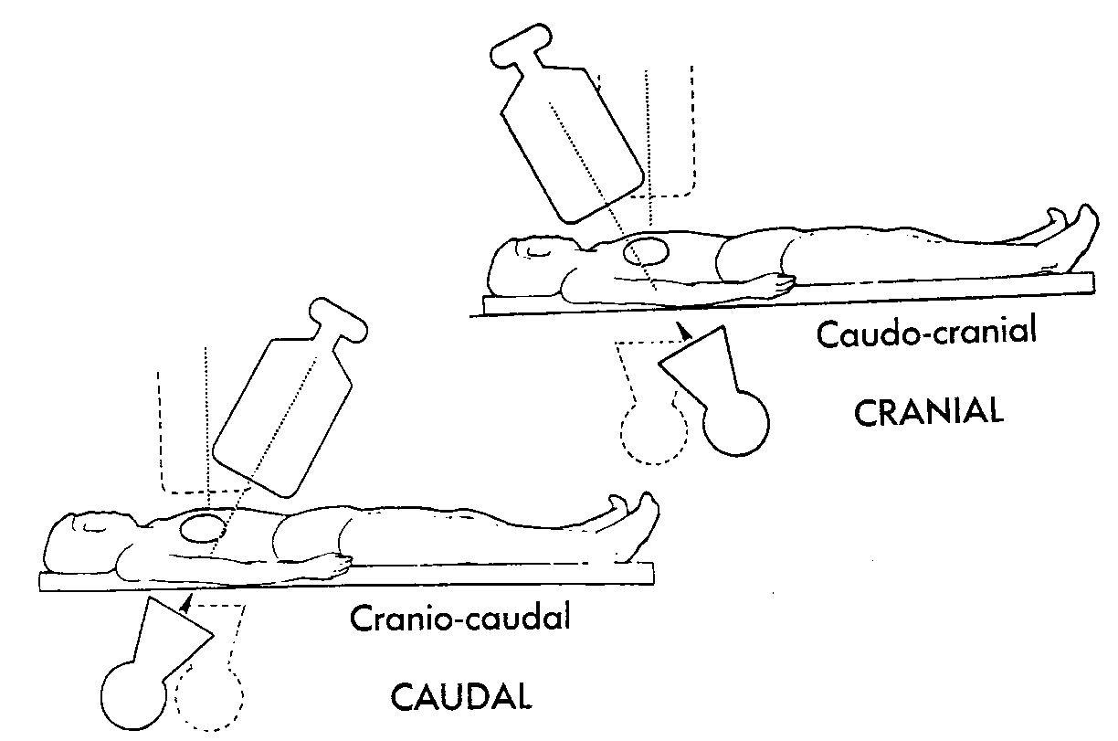

Slide 90
Right Anterior Oblique Projections
RAO-caudal projection (0- 1 0° RAO and 1 5-20° caudal) - excellent view of the left main bifurcation, the proximal LAD, and the proximal to mid LCX.
RAO-cranial projection (0-10° RAO and 25-40° cranial) – mid & distal LAD, with clear view of the origins of the septal and diagonal branches & quite good for examination of the distal RCA or distal LCX.

Slide 91
RAO/Caudal

Slide 92
RAO CRANIAL
LCX – high in cranial views LCx – low in caudal views

Slide 93
RAO CRANIAL

Slide 94
Left Anterior Oblique Projections
The LAO-cranial(60° LAO projection & 15 to 30° of cranial angulation) -Elongates the LM & Prox LAD while projecting the intermedius or first diagonal branch downward off the proximal LCX.
Reducing the angulation to 30 to 40° will usually allow the LAD to fall into the lucent wedge between the right hemidiaphragm and the spine.
The LAOcaudal view ( 40-60° LAO and 1 0-20° caudal) - proj ects the left coronary artery upward from the left main in the appearance of a spider (hence the older term , spider view), and usually offers improved visualization of the left main, proximal left anterior descending (LAD) , and proximal circumflex arteries .
A shallow LAO-cranial view – allows optimal visualization of the distal RCA, its bifurcation into the PDA and the PLV & its complete artery systems .
Notes:
The LAOcaudal view - It is particularly valuable in patients whose heart has a horizontal lie, that is, the origin of the left main artery projects at or below the proximal left anterior descending artery in the standard LAO proj ection.

Slide 95
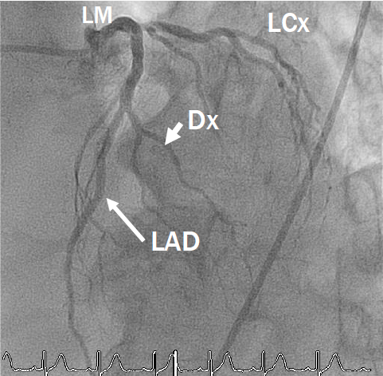
LAO CRANIAL

Slide 96
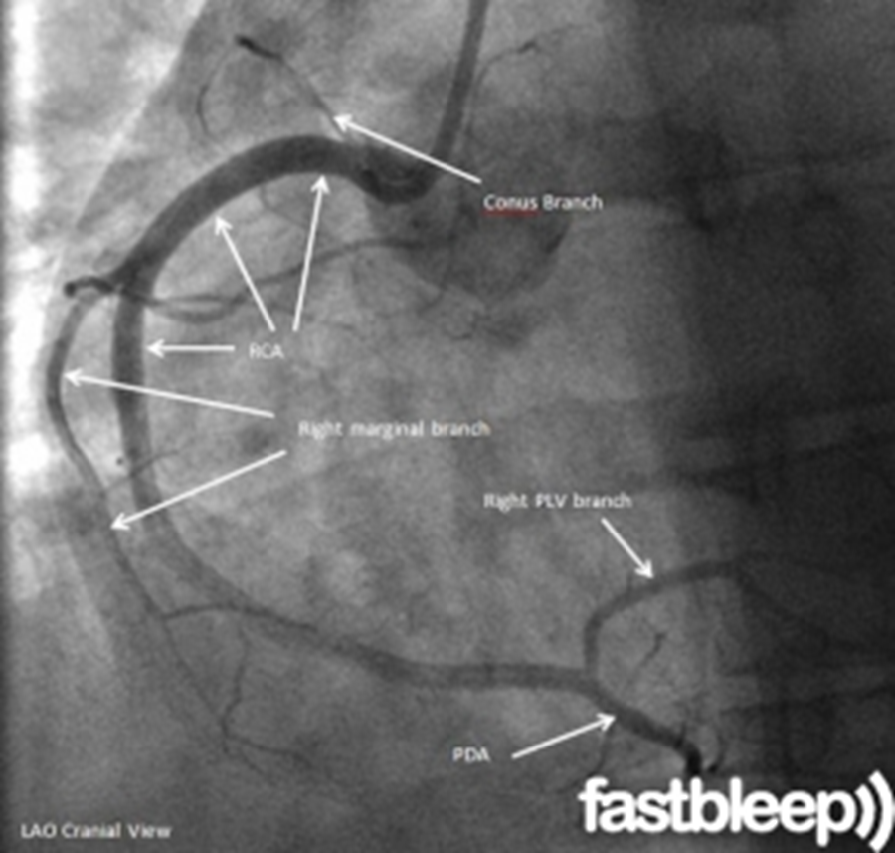
SHALLOW LAO CRANIAL

Slide 97
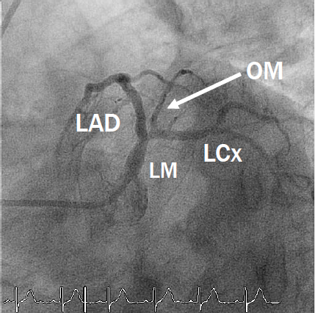
LAO CAUDAL(SPIDER VIEW)

Slide 99
Posteroanterior and Left Lateral Projections
PA projection - Provides the best view of the LM ostium - Because the LMCA curves from a more leftward to an almost anterior direction along its length.
The left lateral projection – useful in examining the proximal LCX and the proximal and distal LAD particularly when combined with slight ( 1 0- 1 5°) cranial angulation.
This projection also provides the best look at the anastomosis of LIMA graft to the mid-distal LAD and offers an excellent look at the midportion of the RCA.
Notes:
The left lateral projection also has the advantage of allowing easy radiographic penetration in most patients when it is performed with both of the patient's hands positioned behind the head, although it generates the highest degree of backscatter given the proximity of the beam entry point on the patient's right side to the operator.

Slide 100
Left coronary artery
1 . RAO-caudal to visualize the left main, proximal LAD ,and proximal circumflex
2. RAO-cranial to visualize the mid and distal LAD without overlap of septal or diagonal branches
3. LAO-cranial to visualize the mid and distal LAD in an orthogonal projection
4. LAO-caudal to visualize the left main and proximal circumflex

Slide 101
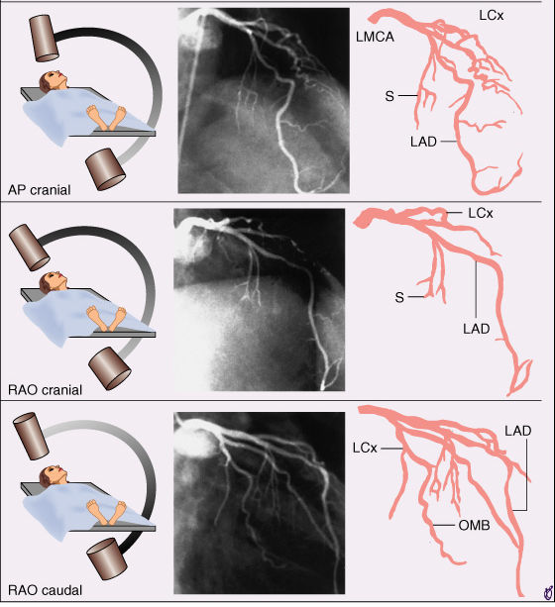

Slide 102
RIGHT CORONARY ARTERY
l. LAO 45 to visualize the proximal and mid right coronary
artery (RCA)
2. LAO cranial to visualize the distal right coronary artery
and its bifurcation into the posterior descending and
posterolateral branches
3. RAO-cranial to visualize the posterior descending and
posterolateral branches
4. Lateral to visualize the mid-RCA

Slide 104
Lesion Quantification
To quantify a coronary stenosis accurately, it must be seen in profile ,free from artifact related to foreshortening by a crossing vessel & Multiple views are important, because many lesions have a markedly eccentric (elliptical rather than round) lumen.
When seen across its major axis , the width of the lumen may appear nearly normal, but a clue to the presence of a severe degree of narrowing in the other axis may be marked lucency caused by thinning of the contrast column.
To distinguish the lucency caused by eccentric stenosis from a similar lucency that may be seen adjacent to an area of contrast (caused by tortuosity or overlapping vessels in the absence of any true abnormality at the site) owing to a perceptual artifact known as the Mach effect.

Slide 105
Major problem in the interpretation of CAG - the severity of stenosis.
Stenosis that reduces the lumen diameter by 50% (cross-sectional area by 75%) is hemodynamically significant in that it reduces the normal threefold-to-fourfold flow reserve of a coronary bed.
70% diameter stenosis (90% cross-sectional area) eliminates virtually any ability to increase flow above its resting level.
Stenoses that reduce the lumen diameter by 90%, however, rarely exist without reducing antegrade flow TIMI grade 1 or 2, rather than TIMI grade 3 normal flow) .

Slide 107
Gibson et al have created norms for the number of cine frames (at 30 frames per second ) required for contrast to leave the catheter tip and reach standardized distal landmarks in each coronary artery (the LAD"mustache" the first posterolateral branch of the right coronary).
Contrast normally reaches these points in 20 frames for the RCA and 36 frames for the LAD , with TIMI 2 (partial) flow corresponding to more than a doubling of these frame counts .
For precise data about hemodynamic lesion significance - calculate the coronary flow or fractional flow reserve

Slide 108
In clinical practice, the degree of lesion stenos is usually just estimated visually ,usually overestimates by 20%.
To resolve this problem.
Project the coronary image on a wall-mounted viewing screen.
Percent stenosis then can be calculated as 100[ 1 - (stenosis diameter/reference diameter) ].

Slide 109
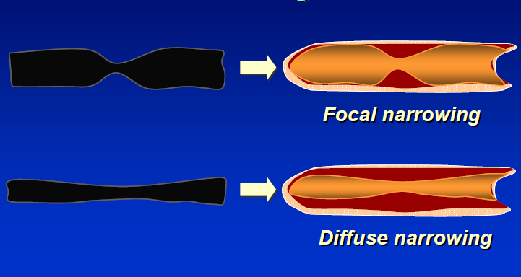
Pitfalls of Coronary Angiography Lumen-o-gram
Each stenosis can be evaluated only by comparison to an adj acent reference segment that is presumed to be free of disease.

Slide 110
HOW TO SOLVE IT
Multiple projection with different angle
Have a sense of normal caliber of major coronaries
4.5 ± 0.5 mm for the left main,
3.7 ± 0.4 mm for the left anterior descending,
3.4 ± 0.5 mm for a nondominant versus 4.2 ± 0.6 mm for a dominant circumflex, and
3.9 ± 0.6 mm for a dominant versus 2.8 ± 0.5 mm for a nondominant right coronary artery.
IVUS examination
Functional study; CFR, FFR

Slide 111
Lesion length
- Discrete: <10 mm in length
- Tubular: 10~20 mm in length
- Diffuse: >20 mm in length
Eccentricity
Concentric
eccentric

Slide 112
Arrangement of the lesion
- Tandem; two lesions located within one balloon length
- Sequential; two lesions located at a distance longer than the balloon
Contour
- Smooth vs. Irregular
- Ulceration; lesions with a small crater consisting of a discrete luminal widening in the area of stenosis.

Slide 113
PROXIMAL VESSEL TORTOUSITY
• Number of >75º bends to reach the lesion
- None
- Mild - one bends
- Moderate - two bends
- Severe - ≥ three bends
LESION ANGULATION
- None/Mild - lesion located on a straight segment or a bend <45º
- Moderate; 45º~90º bend
- Severe; bend >90º
Notes:
Vessel angulation should be measured in the most unforeshortened projection at the site of maximum stenosis using a length of curvature that approximates the balloon length. Balloon angioplasty of angulated lesions increased the risk for dissections, although with the advent of coronary stenting, the inability to deliver the stent and subsequent straightening of the vessel that may predispose to late stent fracture are the largest challenges of highly angulated lesions.

Slide 114
CALCIFICATIONS
- None
- Mild; densities noted only after contrast injection
- Moderate; densities noted only with cardiac motion prior to contrast injection
- Severe; radiopacities noted without cardiac motion prior to contrast injection
THROMBUS
- Discrete, intraluminal filling defect is noted with defined borders and is largely separated from the adjacent wall
- Contrast staining may or may not be present
Notes:
Thrombus - conventional angiography is a relatively insensitive method for detection of coronary thrombus

Slide 115
OSTIAL LESION
• Origin of the lesion ≤ 3mm of the vessel origin
- Aorto-ostial - (LMCA, pRCA)
- Branch-ostial - major epicardial artery
LAD & LCx os
Dx os
OM os
PDA and PL os

Slide 116
Coronary Collateral Circulation
Basic principle of CAG - evident blood supply to all portions of the left ventricle .
These occluded or severely stenotic vessels will frequently be seen to fill late in the injection by antegrade(so-called bridging) collaterals or collaterals that originate from the same (intracoronary) or an adjacent (intercoronary)vessel.
Be carefull - collaterals may be the vascular supply to an organized thrombus(in the left ventricle or left atrium) or a cardiac tumor.

Slide 117
RCA OCCLUSION

Slide 118
LAD OCCLUSION

Slide 120
Bifurcation lesion

Slide 122
Total occlusion
TIMI 0 or 1 &Duration-usually more than 3 months
Angiographic predictor of PCI success/failure

Slide 123
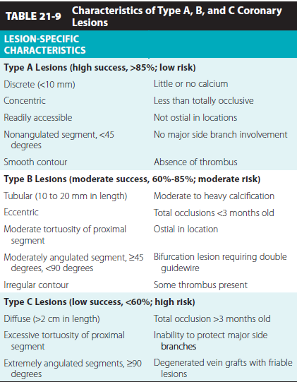
ACC/AHA lesion complexity score

Slide 124
SYNTAX SCORE
An angiographic tool grading the complexity of coronary artery disease
A semi-quantitative visual score that will help us to be aware of the anatomical complexity and to anticipate procedural difficulties

Slide 126
Each lesion is assigned a numerical number and then sum of all lesions score for a patient is calculated to come up with the final numerical SYNTAX score
Patients are divided in 3 groups:
Low <22
Intermediate 23-32
High >32

Slide 127
BIPLANE AND ROTATIONAL CORONARY ANGIOGRAPHY
Biplane - by use of a biplane cardiac cath lab , and it involves obtaining two views during a single injection using the frontal and lateral planes positioned in orthogonal views .
Usually, the lateral plane is positioned in a left cranial or caudal view and the frontal plane is positioned in the contralateral cranial or caudal view (LAO cranial-RAO caudal).

Slide 128
High-speed rotational angiography - Two rotations in caudal and cranial angula tion (LAO to RAO ) are usually performed for the left coronary artery system while a single rotation (LAO to RAO ) is usually performed for the right coronary artery system .
The newest technology has the ability to perform dual axis rotation (Dual Axis Rotational Coronary Angiography or DARA) , in which the c-arm is preprogrammed to make a single-run rotation along a curved trajectory around thepatient, acquiring all the views in a single rotation

Slide 129
MISTAKE S IN INTERPRETATION
Inadequate Number of Projections.
Inadequate Injection of Contrast Material – Because there is inadequate mixing of contrast agent and blood, pockets of nonradiopaque blood may even give the appearance of arterial narrowing.
Congenital Variants of Coronary Origin and Distribution
Superselective Injection –
Gives the impression of total occlusion of the nonvisualized vessel.
Fail to detect significant ostial stenosis , particularly if the catheter tip lies beyond the lesion and adequate contrast reflux is not produced.

Slide 131
Catheter- Induced Coronary Spasm
It is seen most commonly in RCA & more common with the right Judkins catheter, especially if the catheter tip enters the right coronary ostium at an angle and produces tenting of the proximal vessel.
May be related to the catheter itself, possibly caused by mechanical irritation and a myogenic reflex.

Slide 133
Myocardial Bridges - coronary arteries occasionally dip below the epicardial surface under small strips of myocardium.
During systole, the segment of the artery surrounded by myocardium is narrowed and appears as a localized stenosis
Most common in LAD

Slide 134
LAD

Slide 135
THANK YOU

